Slide 1
Chapter 12
Systems Development

Slide 2
Outline
How do you create the software tools needed for your organization?
What main options exist for building information systems?
How do you control a major development project? Why is control so important?
Is SDLC always the best approach? What other methodologies could be used?
How do you analyze and annotate a process-based system?
How is object-oriented design different from process design?
Can software be located in different places?

Slide 3
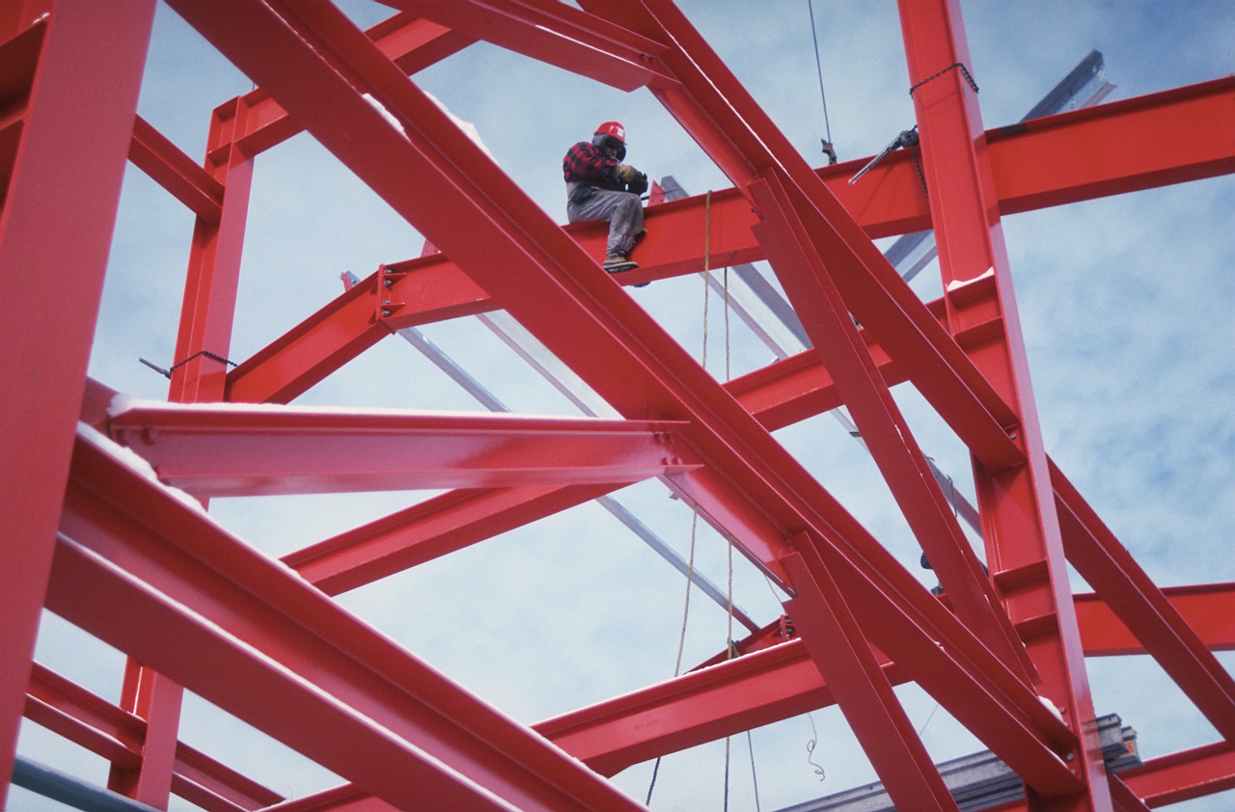


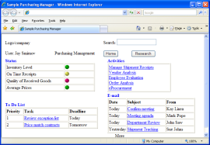
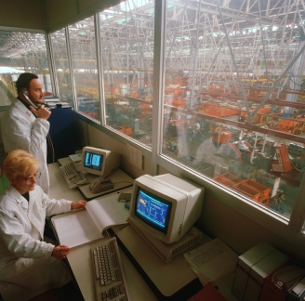
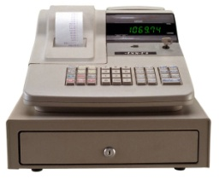
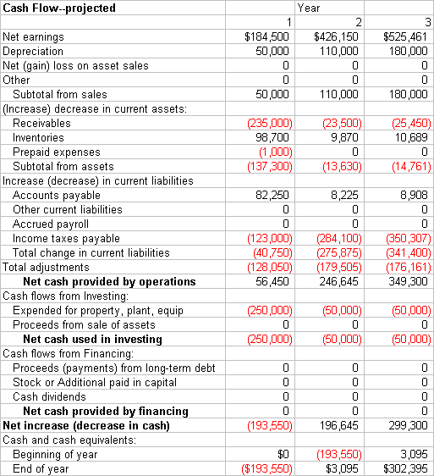
Systems Development

Slide 4

Runaway Projects
Technical measures
2 - 5 times over budget
2 - 5 times behind schedule
Missing technical objectives
Design problems
Duplication of efforts
Incompatibilities
User/designer conflicts
$
2012
2013
2011
 |  |  | 1 | 2 | 3 | 4
5 | 6 | 7 | 8 | 9 | 10 | 11
12 | 13 | 14 | 15 | 16 | 17 | 18
19 | 20 | 21 | 22 | 23 | 24 | 25
26 | 27 | 28 | 29 | 30 | 31
2014

Slide 5
Common Problems
Confusion over who is working on each part.
Program portions do not work together.
Users have minimal and conflicting input.
Programmers and developers leave.
Work is duplicated or discarded.
Goals are uncertain or changing.

Slide 6
Success & Failure
Reasons for Success
User Involvement
Executive management support
Clear requirements
Proper planning
Realistic expectations
Reasons for Failure
Lack of user input
Incomplete requirements
Changing requirements and specifications
Lack of executive support
Lack of technical skills
Cafasso 1994

Slide 7
Build or Buy Options
Purchase complete solution
Assemble from components
Outsource or contract programmers
Custom programming
Development time
Longer development time means more risk, possibly higher costs. But it also enables you to create a more customized solution.

Slide 8

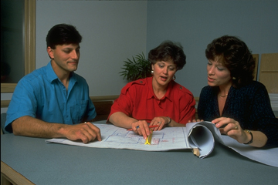

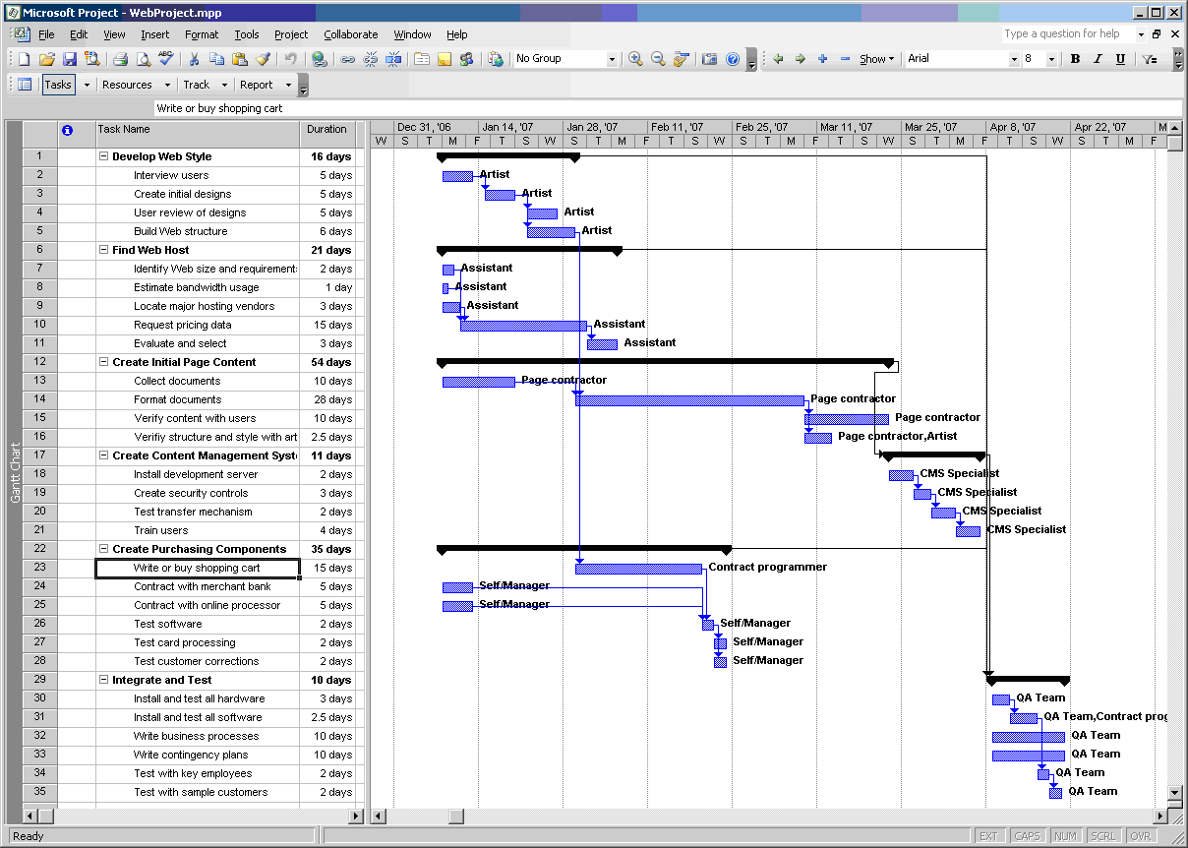

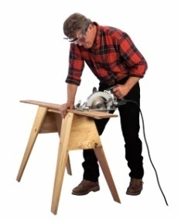
Primary Methodology Choices
Large projects, formal control
Systems development life cycle
Decision support, analyses, and reports
Prototyping
Single user, reports and one-time computations
End user development

Slide 9
Custom Code
Get custom/unique code
Special features
Integrate with existing systems
Need programmers
Hire or outsource
Manage them
Need to maintain the code
Your upgrades
System upgrades (Windows changes)

Slide 10
Outsourcing and Contract Programmers
Part time or task-oriented
Negotiate time, price, outcome
Communication
Need to know exactly what system will do
Need to communicate accurately
Need to monitor progress
In tight economy it can be hard to find good programmers
Best if you can specific a fixed-price contract but the output has to be precisely defined
(More detail in Chapter 13)

Slide 11
Components
Commercial—buy elements
Free/open source
Some are good, some are weak: test
Having access to code helps, in case you need to rewrite them
Problems with upgrades
Component upgrades, break compatibility
Windows or system upgrades might mean need for new components—which might disappear
Web services
Consider how long the system will need to be in operation

Slide 12
Programming Basics
Sequential execution: Statements are executed in order.
Parallel execution: Groups of code are executed at the same time.
Variables: Containers to hold data
Computations
Conditions: If – Then – Else
Loops: While – End
Subroutines and Functions: Break code into manageable pieces.
Input/Output: Transferring data
Objects: Code pieces purchased or created to do specific tasks.

Slide 13
Sample Code Structure
Variable Total = 0
Open Sales
While NOT Sales.EOF
Total = Total + Sales.Value
Sales.MoveNext
End
Print Total
Close Sales
Declare and initialize variable
Loop through file/query one row at a time until end of file
Retrieve value and accumulate in Total variable
Sales Query/File
Value
13
22
18
17
Memory Space
Total: 0
Open/start
13
Total = Total + Sales.Value
13 = 0 + 13

Slide 14
Programming Languages (small list)
http://www.tiobe.com/index.php/content/paperinfo/tpci/index.html
Language | Main Purpose or Context
Java | General purpose. Designed to run on servers and clients.
C#, VB, ASP .NET | Microsoft used for Web servers and applications. Managed code.
Javascript, HTML5 | Script language for Web page interactivity.
C++, C | Compiled, powerful, lower-level languages often used for systems and tools or where speed is critical.
PHP, PERL, Python, Ruby | Web server scripting/dynamic languages often used on Linux/UNIX or Apache Web servers.
Objective-C | Apple’s language for iPhone/iPad applications.
Flash, (Adobe) Silverlight (Microsoft) | Special purpose Web add-ins with code to control interactivity. Silverlight uses C# or VB.
COBOL | Older business applications and SAP.
FORTRAN | Older scientific programming applications. See F#.

Slide 15
Individual Development: Pseudocode
Project Evaluation (given a discount factor)
Get list of cost items from the user
(Description, value, time-incurred, probability-factor, category . . .)
Examine each item in the list:
Compute the present value of the cost:
PV = Cost / ( (1 + rate) ^ time)
Multiply by the probability factor:
EV = probability * PV
If item is in a special category,
Then add or subtract correction:
category = Land Add 10%
category = Overhead Subtract 5%
category = Labor Add 15%
End If
Accumulate the total value
End of list
Return the Total value

Slide 16
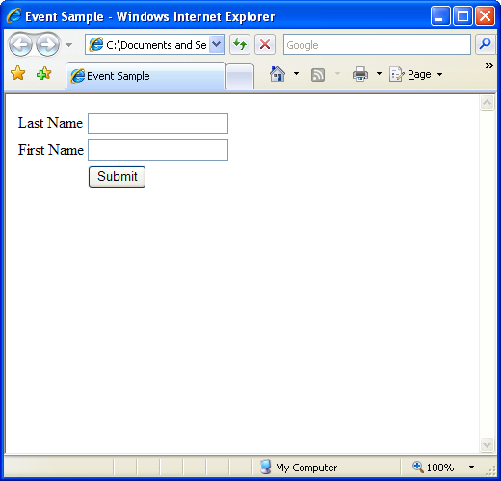
Event-Driven Environments
onactivate onafterupdate onbeforeupdate onbeforecopy onbeforecut onbeforedeactivate onbeforeeditfocus onbeforepaste onbeforeupdate onblur onclick oncontextmenu oncontrolselect oncopy oncut ondatabinding ondblclick ondeactivate ondisposed | ondrag ondragend ondragenter ondragleave ondragover ondrop onerrorupdate onfilterchange onfocus onfocusin onfocusout onhelp oninit onkeydown onkeyup onload onlosecapture onmousedown onmouseenter | onmouseleave onmousemove onmouseout onmouseover onmousewheel onmove onmoveend onmovestart onpaste onprerender onpropertychange onreadystatechange onresize onresizeend onresizestart onselectstart onserverclick onunload
Events for the Submit button.
Check back tomorrow, there might be more.

Slide 17
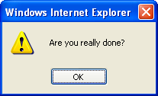
Sample Javascript Web Event
This simple code runs.
But it is a terrible user interface.
The art of programming revolves around building applications that solve problems and are easy to use.
<input type="submit" value="Submit" name="submit" onmouseover="ShowMessage('Are you really done?');" />
<script language="javascript">
function ShowMessage(msg)
{
alert(msg);
}
</script>
SampleJavaScript.html

Slide 18
Object-Oriented Programming
Encapsulation
Object Hierarchies
Inheritance
Polymorphism
Object name:
Account
Number Beginning Balance
Name Ending Balance
Client Current Balance
Manager Interest Rate
Date Opened
Object attributes/properties:
Object functions/methods:
Open Acct Accept Deposits
Close Acct Withdrawal
Pay Interest
Savings
Interest Rate
Monthly Fees
Checking
Lowest Balance in Month
Bad Check Charges
Authorized Signature
Pay Interest
Compute Charges
Print Quarterly Statement
Print Monthly Statement
Send Bad Check Notice
Pay Interest
Budget Saver
Money Market
Volume
Senior Citizen
CD
Fixed Fee
Student

Slide 19
Top-down and Bottom-up
Identify Management
Functions and
Operations
Entire Organization
Design Systems
Data
Programs
Standards!
Integrate
Write code
Build DB
Find a problem
Management
Functions
Functions
Operations
Operations
Operations
Databases
Databases
Databases
Databases
Databases
Programs
Programs
Programs
Programs
Programs
Programs
Programs
Programs
Programs

Slide 20
Risks on Large Projects
Personnel shortfalls
Unrealistic schedules and budgets
Developing the wrong functions and properties
Developing the wrong user interface
Gold plating (adding more functionality/features than necessary)
Continuing stream of requirements changes (scope creep)
Shortfalls in externally furnished components
Shortfalls in externally performed tasks
Real-time performance shortfalls
Straining computer-science capabilities
Boehm, 1991

Slide 21
Communication: Adding People
Adding people helps only if independent tasks can be assigned to each person.
Adding people always increases communication needs.

Slide 22
Systems Development Life Cycle
Feasibility &
Planning
Goals & plans
Systems
Analysis
Business requirements
Systems
Design
Proposal
Technical Design
Systems
Implementation
Problems &
Improvements
New System
Existing System
revisions
problems
revisions
problems
Systems Maintenance: Incremental changes

Slide 23
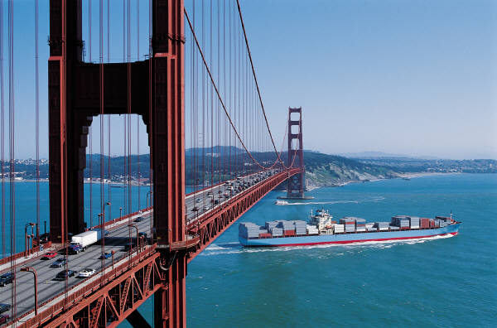
Development Controls
Detailed work plan
Performance targets
Practices & procedures
User input & control
Blue Print/Planning

Slide 24
Feasibility
What exactly is the project and is it worth doing?
Scope and Goals
People/Groups
Benefits and Costs
Schedule
Alternatives

Slide 25
Systems Analysis
Understand the business/organization
Determine specific business requirements
Identify problems with existing systems
Find specific goals
Evaluate Alternatives (Buy v. Build)
Collect test cases

Slide 26
Systems Development
Design databases
Design user interface
Buy components
Design and write applications (15-30 percent of the total time)
Initial testing and feedback
Write documentation and help

Slide 27
Systems Implementation
Final testing
Involve users
Education and training
Flexibility
Recognize how the system will affect the business
Encourage users to change
Implementation plans
Education and training
Changing
Business operations

Slide 28
Implementation Options
Direct cutover
old
new
old
Parallel
old
new
store 1
new
Pilot
store 2
new
store 3
new
store 4
new
old
new
dept or component 1
dept or component 2
Phased
dept or component 3
dept or component 4

Slide 29
Comparison of Diagrams
Data Flow Diagram
Show process and flow of data.
Focus on process
Split by showing increasingly detailed levels of process.
Entity Relationship or Class Diagram
Describe business data objects.
Focus on data and relationships.
Split by entities or object inheritance.

Slide 30
System Evaluation
Feasibility Comparison
Cost and Budget | Compare actual costs to budget estimates.
Time Estimates | Was project completed on time?
Revenue Effects | Does system produce additional revenue?
Maintenance Costs | How much money and time are spent on changes?
Project Goals | Does system meet the initial goals of the project?
User Satisfaction | How do users (and management) evaluate the system?
System Performance
System Reliability | Are the results accurate and on time?
System Availability | Is the system available on a continuous basis?
System Security | Does the system provide access only to authorized users?

Slide 31
SDLC Advantages & Disadvantages
Advantages
Control & targets
Formality
Financial controls
User input
Documentation
Testing
Ease of maintenance
Disadvantages
Increased costs
Increased time
Hard for DSS
Requires definitions up front
Rigid

Slide 32
Capability Maturity Model
Initial. Ad hoc development with undefined processes. Often driven by individual programmers.
Managed. Standard project management tools to track costs and schedules. Basic processes to ensure development is repeatable.
Defined. Management and development is defined and standardized. Processes are documented and followed.
Quantitatively Managed. Detailed measures are collected and evaluated.
Optimizing. Continuous improvement methods are applied to fine tune and improve the development process
http://www.sei.cmu.edu/cmmi/
Evaluating an organization’s ability to develop software.
Process improvement

Slide 33
Prototyping
MIS Designer
User
Initial Interview
Build Initial Prototype
New Version
Use Prototype
Request changes
Modify Prototype
1) User is satisfied
2) User and designer give up
3) Formal system is built from prototype
4) Need for application is removed
5) Process never ends
Process repeats until:

Slide 34
Prototyping Evaluation
Advantages
Get a working system earlier
User has more input
Designed to be modified
Problems
Need 4GL trained MIS staff
Too many users
Too many analysts
Never finish
"Loss" of management control
Best uses
Single user
Reports
Input screens
Self-contained applications

Slide 35
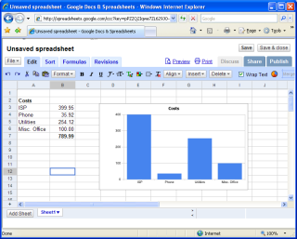
Extreme Programming and Agile Development
Release 1.0
Release 1.1
time
Target release dates.
Build test cases.
Write code and test it.
Release product.
Add features for next release.
Paired programming
Test cases
Inputs: 16, 7, 19
Output: 91

Slide 36
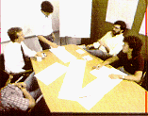
Developing Systems with Teams
Developing systems is generally a team effort among MIS developers and business users. Groupware, CASE, and development tools are often used to facilitate communication and coordination.

Slide 37




Joint Application Design
Get everyone together to identify the primary elements of the design with no distractions.
Goals
Primary Needs
Computations
Forms
Database

Slide 38
Teamwork Development
Coordination
Technology
Control
Information
Sharing
Change
Monitoring
Access
Control
Data
Sharing
Concurrency
Control
Consistency
Enforcement
Product
User

Slide 39
Open Source Development
Lead developer
Multiple programmers
Everyone can see and modify the source code
Typically, user companies pay for support—sometimes to the lead developer
See GNU (Richard Stallman) and http://www.sourceforge.net

Slide 40
End-user Development
Advantages
Faster
Cheaper
Get what you want
Disadvantages/Problems
Lack of documentation
Individual/personal differences
Pre-packaged software limitations
Takes User time

Slide 41
End-user Development When to Call for Help
Many people use the system
PC versus central computer
Need documentation
Individual user differences
Need to train users
Commercial software limits
User time is expensive
Mission critical application
Additional testing
Many modifications
Need security & control
Need to integrate
Use corporate data
Tie to existing software
Connect to network
Database Integrity
Avoid duplicate data
Changes to corporate data

Slide 42
Who Should Develop Systems?
MIS
Size: Many users
Complexity: Different departments
Long development time
SDLC large project controls
Cost of user time
Critical Information
Major changes to central data base
Formal testing
Expensive hardware
Formal feasibility
Compatibility
Specialized knowledge
End User
One-time code
Can purchase pre-packaged solutions
Highly trained users
How Can MIS Help?
Easy access to data/database
Advice and help
Testing & quality control
Training & tutorials
Support/Help Center

Slide 43
Choosing Methodologies
 | SDLC | RAD | Extreme Programming | JAD | Prototyping | End User
Control | Formal | MIS | Time | Joint | User | User
Time frame | Long | Short | Short | Medium | Short | Short
Users | Many | Few | Few | Few | One or two | One
MIS staff | Many | Few | Many | Few | One or two | None
Trans/DSS | Trans. | Both | Both/DSS | DSS | DSS | DSS
Interface | minimal | Minimal | Good | Crucial | Crucial | Crucial
Document. & Training | Good | Limited | Variable | Limited | Weak | None
Integrity & Security | Vital | Vital | Good | Limited | Weak | Weak
Re-usability | Limited | Some | Maybe | Limited | Weak | None
Methods can be combined in a project.

Slide 44
A Systems Approach to Process Analysis
Systems
Input, Process, Output
Divide and Conquer
Goals and Objectives
Control and Feedback
Diagramming Systems
Common Systems Problems
Basic Systems
input
Process
output

Slide 45
Goals and Feedback
Process
Input
Output
Goal
Control
Analyze
Feedback

Slide 46
System boundary: The Zoo
Members
Donors
Visitors
Requests
& Comments
Suppliers
Money
Animal Feed
Invoices
The
Zoo
Health Data
Education
Baby
Animals
Visitor Counts
Registration
Papers
Other Zoos
Educational
Materials

Slide 47
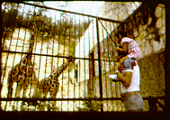
Subsystems: The Zoo
Donor &
Public
Relations
Animal
Care
Manage
Human
Resources
Produce
Management
Reports
Manage
Facilities

Slide 48
Data Flow Diagram Objects
External Entity
External Entity
Process
Data Store (file)
Data Flow
Data Flow
Feedback and Control Data
Feedback and Control Data

Slide 49
The Zoo: Level 0
zoo booster
members
public/
zoo visitors
donors
PR data
receipts
etc.
animal requests
other zoos
& breeders
money &
requests
public requests
1
donor and
public relations
4
animal
care
receipts
needs & budgets
health research
2
produce
mgt. reports
specialist request
animal status
emp. schedule
emp. reports
maint. &
building
request
3
manage
human
resources
hours,
benefits,
etc.
specialist
request
maintenance
schedule
employees
employee
schedule
pay data, requests
5
manage
facilities
Management
reports
certification
agencies
Usage
reports
management

Slide 50
The Zoo: Level 1
public/
zoo visitors
money &
comments
donors
zoo booster
members
receipts
newsletter
notices, etc.
PR data
receipts
etc.
money &
requests
money &
suggestions
1.1
produce PR
& outreach
programs
1.2
handle
donor
requests
1.3
org. booster
services &
meetings
donor
requests
needs &
plans
booster
requests
money, data,
visitor statistics
donor
lists
public requests
needs &
plans
1.4
track needs
and donor
programs
1.5
produce
accounting
& reports
expenses & budget
needs & budgets
animal
needs
public requests
accounting
reports
adopt an animal
files

Slide 51
Systems: Data Dictionary
Processes
Animal Care Description
Donor & Public Relations . . .
Employee Relations . . .
Entities
Certification Agencies . . .
Donors . . .
Data
Accounting Reports . . .
Certification Reports . . .

Slide 52
Data Dictionary

Slide 53
System Problems
Do not include data flows between external entities. Drop the line or make one of the entities internal.
warranty registration
Manufacturer
Customer
purchase orders
orders
Invoices
Sell Products
sales receipt
A process cannot be a black hole--data must flow out of the process. Maybe it should be a file instead.
A process cannot invent data. It must have a data flow coming in to it.
Store reports
weekly report
Save Reports
Modify Reports
daily sales
Inventory list

Slide 54
Boundaries
Visitors
Zoo system boundary
Distribute
Educational
Materials
Create
Educational
Materials
Problem Boundary
Problem: Shortages of Educational Materials

Slide 55
Common Systems Problems
Defective subsystems
Wrong Data
Errors in Data
Missing feedback and control
Not responding to environment
Receive
Orders
Check
Customer
Credit
Check
Orders
for Errors

Slide 56
Identifying Cause & Effect
zoo booster
members
donors
PR data
receipts
etc.
money &
suggestions
newsletter,
notices,
etc.
money &
requests
1.3
Booster
services &
meetings
1.2
Handle
donor
requests
needs &
plans
booster requests
needs &
plans
public requests
donor lists
1.4
Track needs
& donor
programs
donor requests
needs & budgets
expenses & budget
donor list &
animal needs
animal needs
& plans
Problems
Some animal budgets have excess $
Some animal budgets have no money
adopt an animal
files

Slide 57
Object Orientation
Object Orientation
Properties
Methods
Inheritance
Polymorphism
Business Objects and Processes

Slide 58
SDLC v. Object Oriented

Slide 59
Objects & Events
Events
Methods
Objects
Sale
Record Sale
Update Inventory
Notify Customer Service
Transaction Log
Accounts & Ledgers
Inventory
Customers
Employees (commissions)
Inventory
Order/JIT
Notify Suppliers
Schedule Payment
Accounts & Ledgers
Suppliers
Shipping/Receiving
Installation
& Maintenance

Slide 60
Rolling Thunder Order Entry Process
BikeSizes
New order
Order Entry
Clerk
Est. sizes
Bicycle
Retail data
Retail Store
Select
BikeTubes
Customer
Choices
Select
Customer
BikeParts
Components
Pricing

Slide 61
Rolling Thunder Manufacturing Process
Frame
Assembler
Painter
Build
Paint
BikeTubes
QOH
TubeMaterial
Install
Bicycle
Customer
BikeParts
Components
QOH
Install
Customer
Transaction
Ship
Installer

Slide 62
Rolling Thunder Purchasing Process
Purchase
Order
Purchase
Items
Order
QOH
Components
Purchase
Employee
Payable
Manufacturer
Transaction
Receive
Manufacturer
Dock employee

Slide 63
Some Classes for Rolling Thunder
Customer
Bicycle
Customer
Customer
BikeTubes
1
1
*
CustomerID
Phone
FirstName
LastName
Address
ZIPCode
CityID
BalanceDue
*
SerialNumber
CustomerID
ModelType
PaintID
FrameSize
OrderDate
StartDate
ShipDate
ShipEmployee
FrameAssembler
Painter
Construction
WaterBottle…
CustomName
LetterStyleID
StoreID
EmployeeID
…
SerialNumber
TubeName
TubeID
Length
1
Components
1
ComponentID
ManufacturerID
ProductNumber
Road
Category
Length
Height
Width
Weight
Description
ListPrice
EstimatedCost
QuantityOnHand
BikeParts
SerialNumber
ComponentID
SubstituteID
Location
Quantity
…
*
*
*
Manufacturer
ManufacturerID
ManufacturerName
ContactName
Phone
…
1

Slide 64
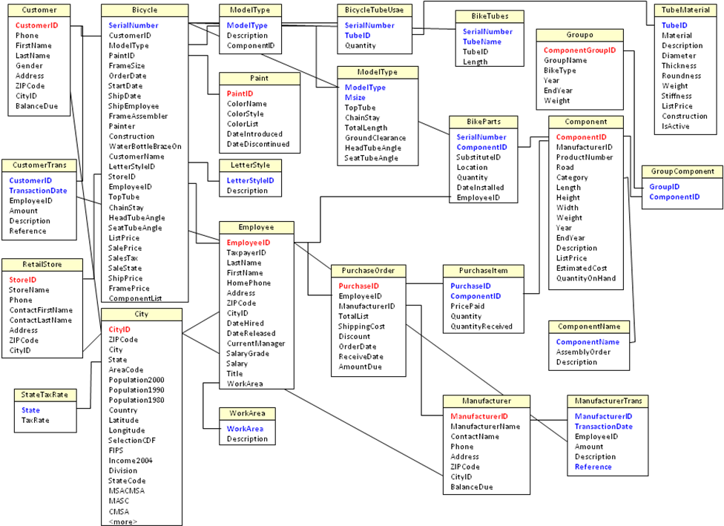
Rolling Thunder Bicycle Class Diagram

Slide 65
Simple Object Access Protocol
Your Company Server
The Internet
Bank Server
Bank Service
Your Financial Application
SOAP
Currency converter: Date, InCurrency, Outcurrency
Manager or Client

Slide 66
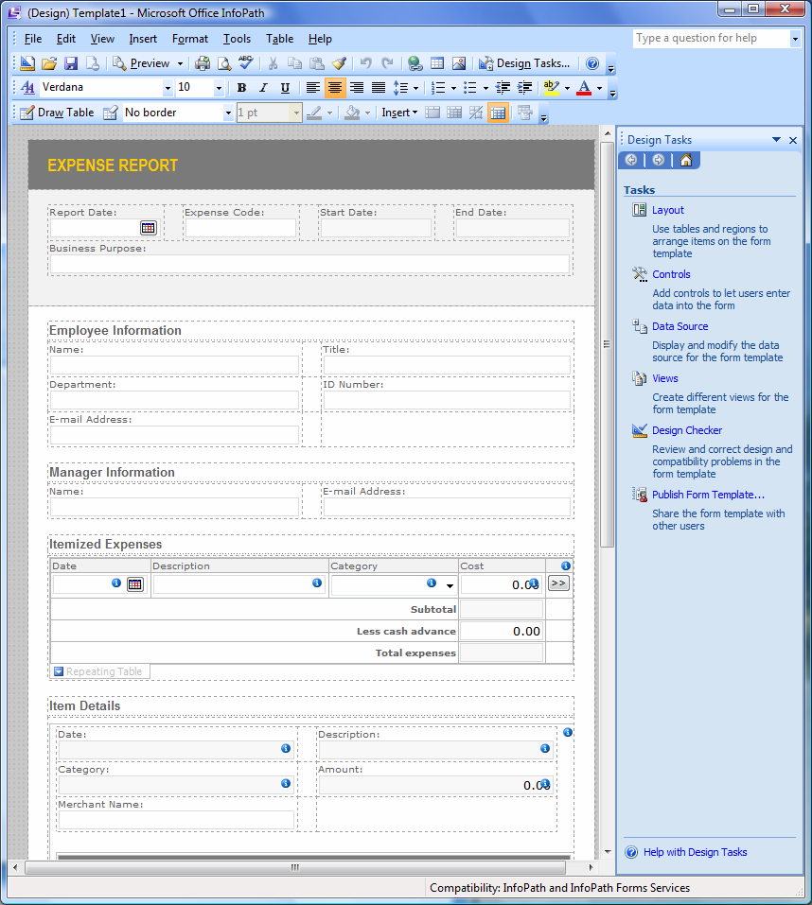
Technology Toolbox: InfoPath
Use the sample Expense Report to create a form.
Use the designer to verify or alter the design.
Publish it and e-mail to test it.

Slide 67
Quick Quiz
What standard business forms would you want to create electronically?
What security conditions would you impose when installing expense report forms on a SharePoint server?
What are the benefits of using digital forms instead of paper forms?

Slide 68
Technology Toolbox: Programming Excel
BlackScholesVB.xls
Function BlackScholes(CallPut As String, StockPrice As Double, ExercisePrice As Double, _
TimeLeft As Double, rate As Double, volatility As Double) As Double
Dim d1 As Double, d2 As Double
d1 = (Math.Log(StockPrice / ExercisePrice) + (rate + volatility ^ 2 / 2) * TimeLeft) / _ (volatility * Math.Sqr(TimeLeft))
d2 = d1 - volatility * Math.Sqr(TimeLeft)
If (Left(CallPut, 1) = "c") Then
BlackScholes = StockPrice * Application.WorksheetFunction.NormSDist(d1) _
- ExercisePrice * Exp(-rate * TimeLeft) * Application.WorksheetFunction.NormSDist(d2)
Else
BlackScholes = ExercisePrice * Exp(-rate * TimeLeft) * _
Application.WorksheetFunction.NormSDist(-d2) - StockPrice * _
Application.WorksheetFunction.NormSDist(-d1)
End If
End Function
stock price | 60 |  | call | 2.133368
exercise price | 65 |  | put | 5.846282
time left | 0.25
rate | 0.08
volatility | 0.3
=BlackSholes(“call”, B2, B3, B4, B5, B6)

Slide 69
Quick Quiz: Programming in Excel
1. What does the statement “If (ILeft(CallPut, 1) = “c”) do in the code?
2. What security setting do you need for this function to work?
3. How can a function directly alter several cells in a spreadsheet?

Slide 70
Cases: Government Agencies

